Slide 1
Chapter 2 Hamiltonian cycles

Slide 2
Commercial or not commercial
Finger Mathematics: Study mathematics with our fingers
Keep the question in mind: Who is the reader?

Slide 3
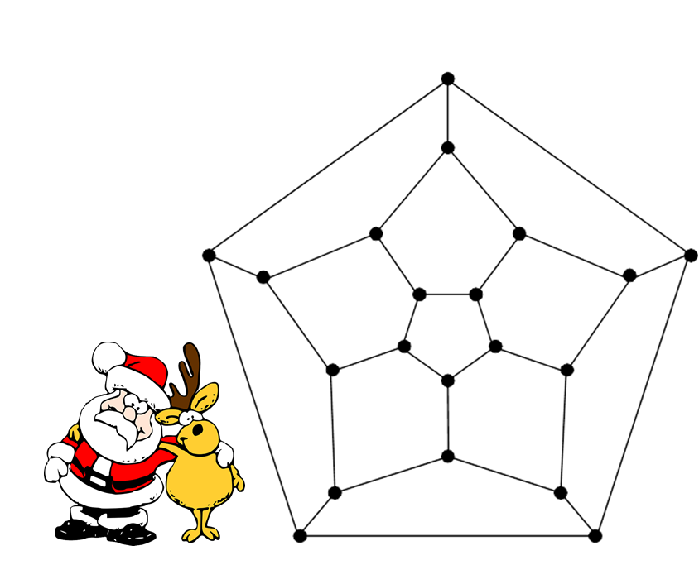
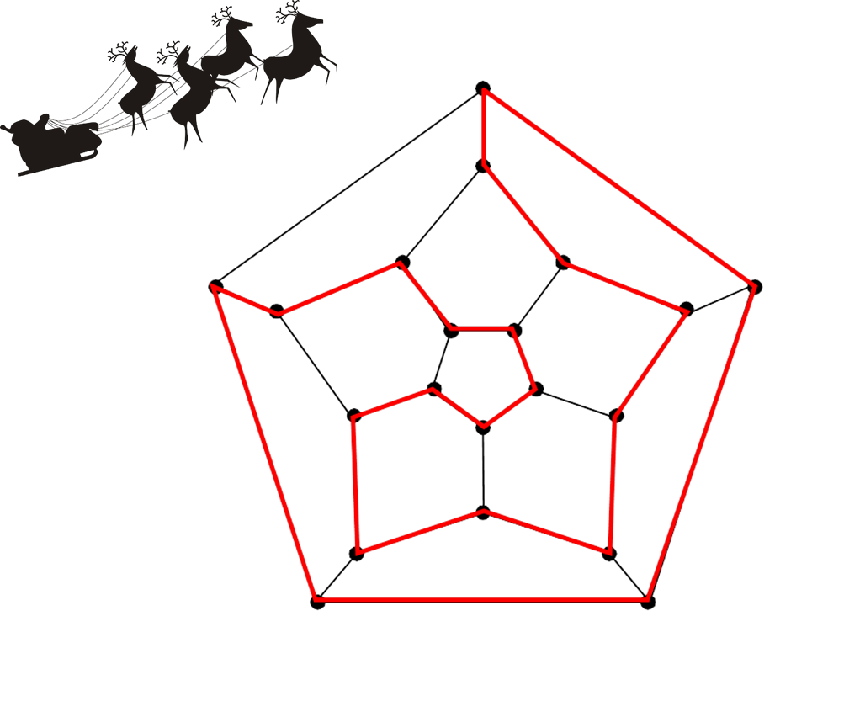
Figure 2-1
Figure 2-2

Slide 4
Figure 2-2

Slide 5
The problem was proposed in 1855 by the Irish mathematician Sir William Hamilton (1805-1865). Since an answer must be a cycle, any arbitrary vertex may be selected as the starting point of the tour, meaning that the particular choice made is irrelevant and unimportant. Such a cycle is called a Hamiltonian cycle, in honor of Hamilton.

Slide 6
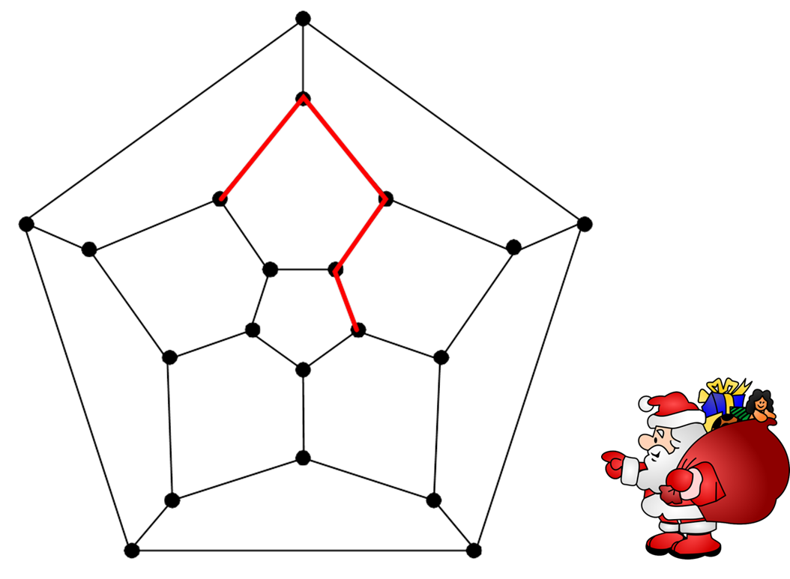
Figure 2-3

Slide 7
Variation of Hamiltonian problem

Slide 8
Figure 2-5

Slide 9
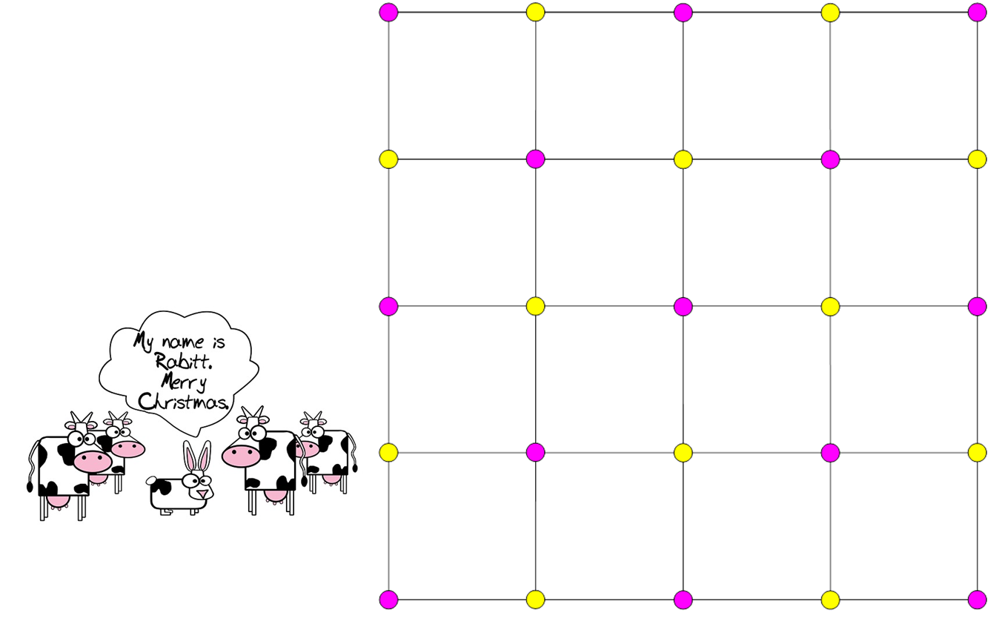
Figure 2-6

Slide 10
Non-Hamiltonian graphs
Theorem 2.1. Every cycle of a bipartite graph traverses the same number of vertices of each color class. Moreover, it must traverse at least two vertices of each color. In particular, every Hamiltonian bipartite graph has an even number of vertices.

Slide 11
Theorem 2.2. Let S be any vertex subset of a Hamiltonian graph G. Suppose that S has s elements. Then the graph obtained from G by deleting all the vertices of S has at most s connected components.

Slide 12
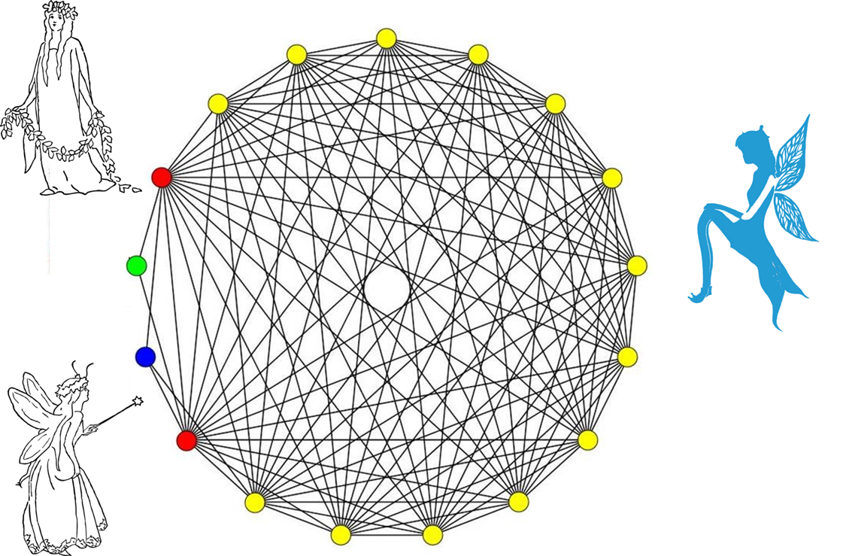

Slide 13
Puzzles

Slide 15
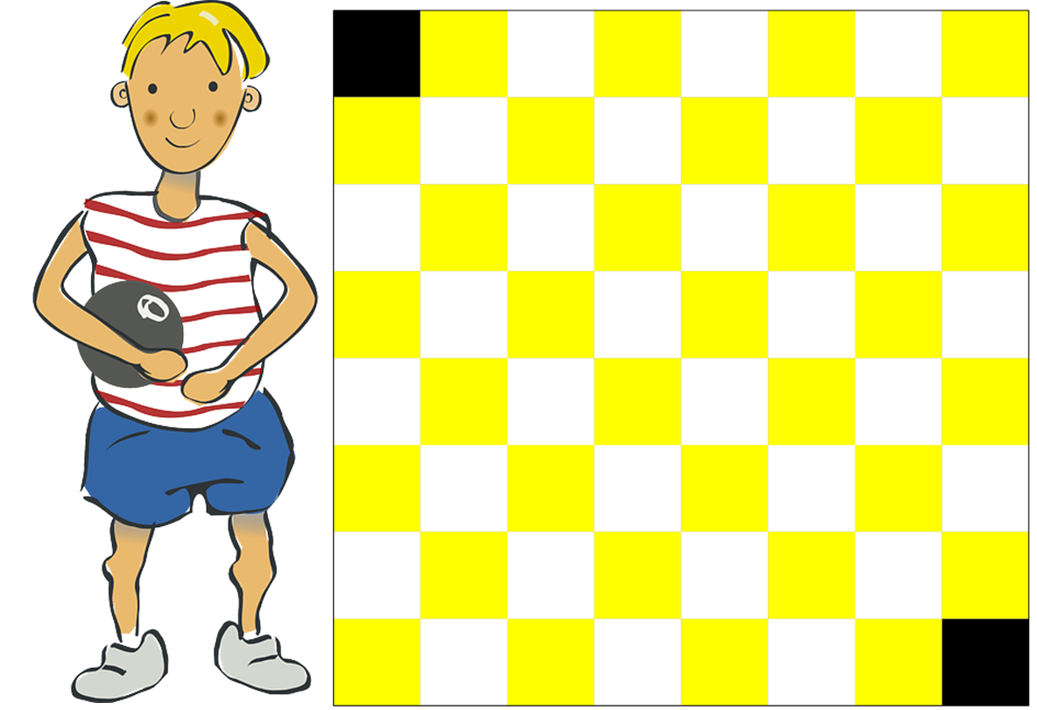

Slide 16
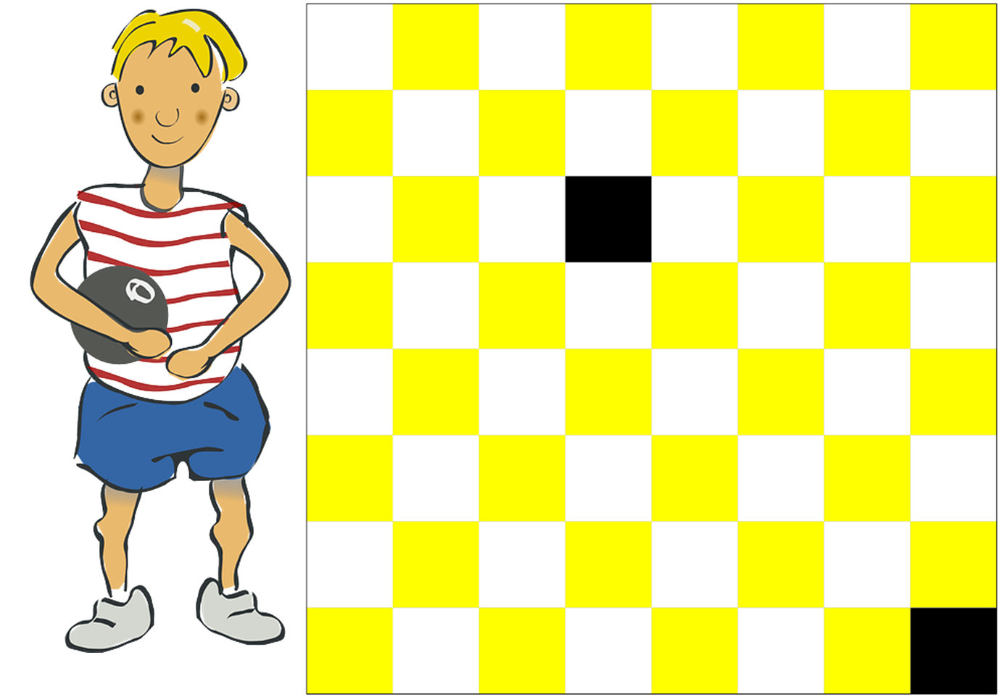

Slide 17
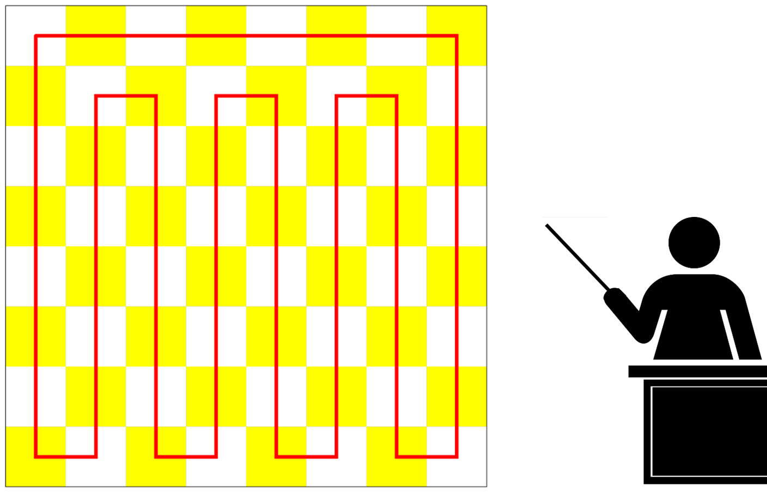

Slide 18
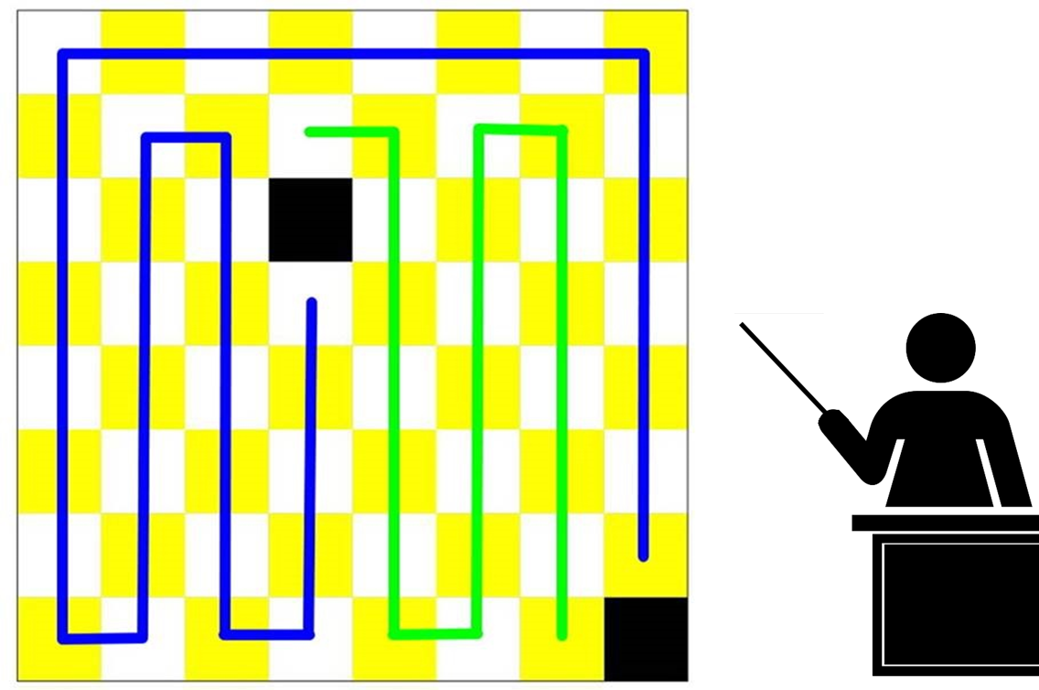

Slide 19
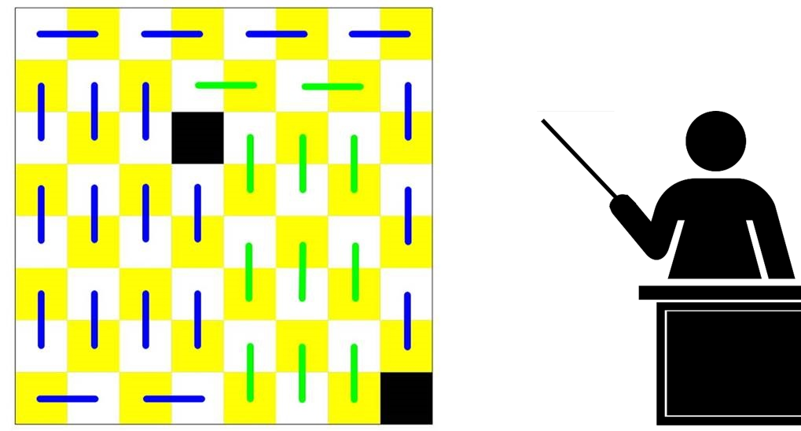

Slide 20
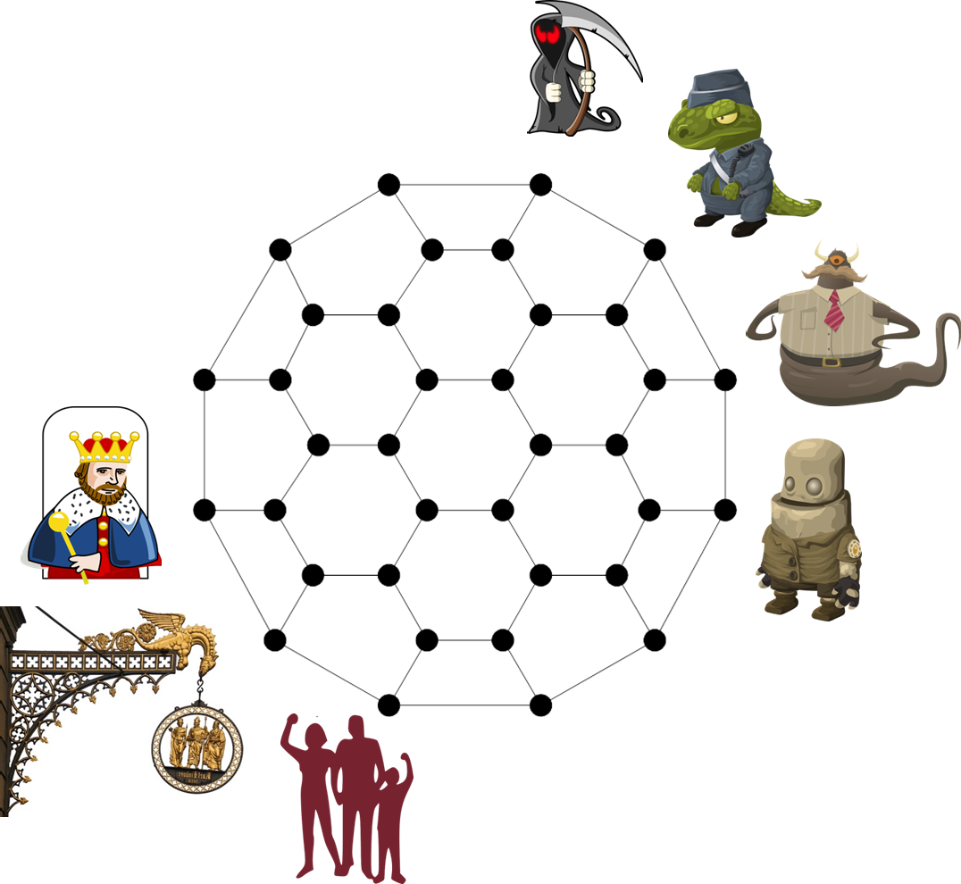
Tait coloring

Slide 21
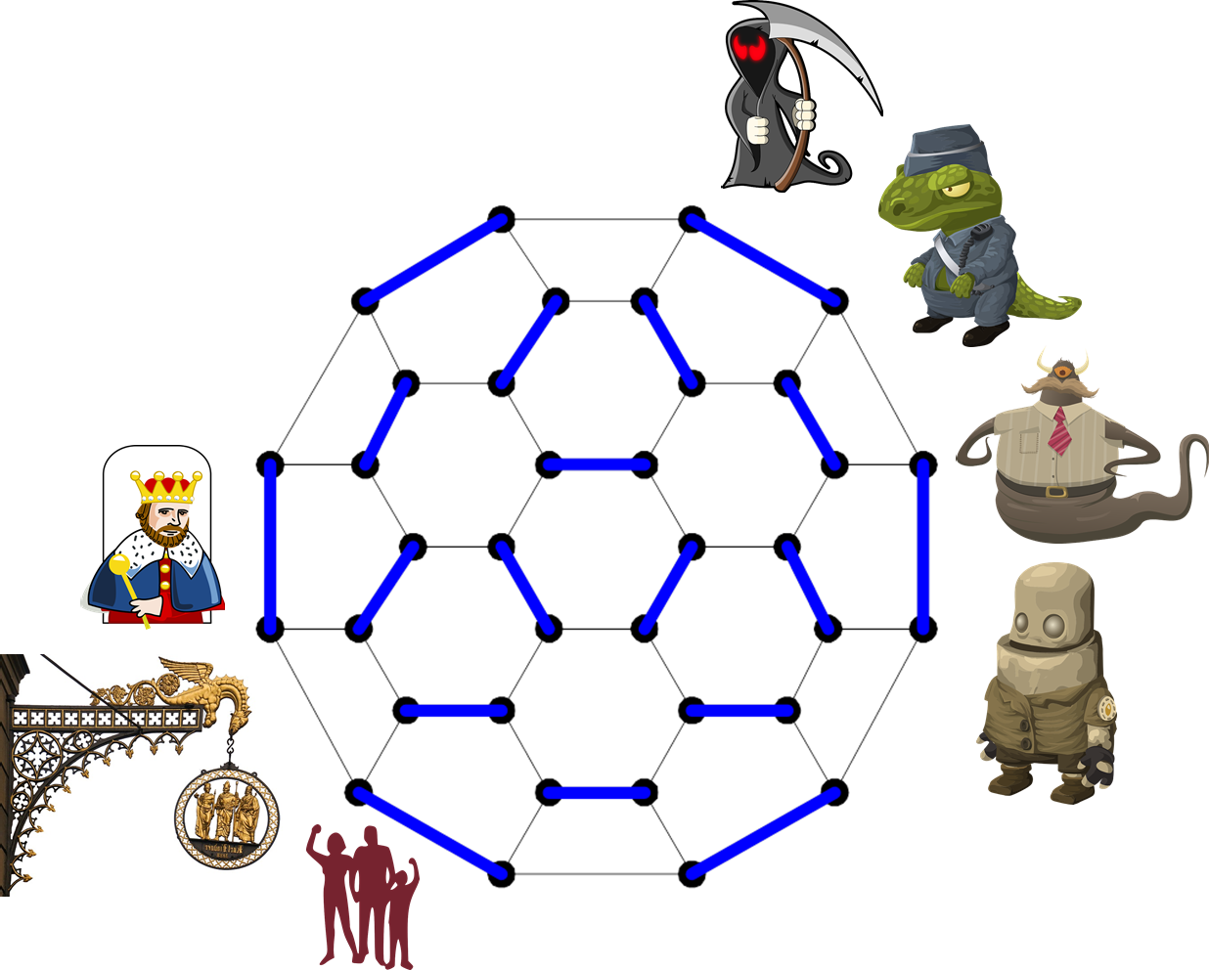

Slide 22
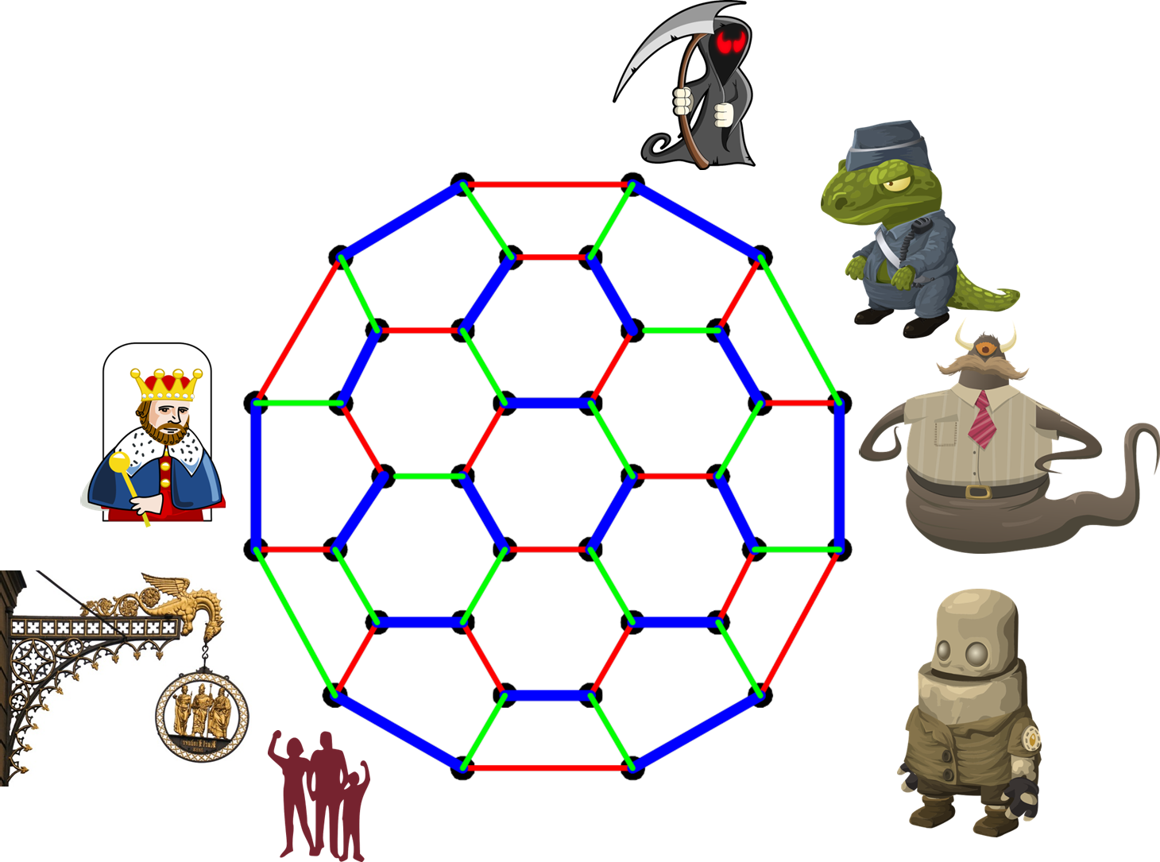

Slide 23
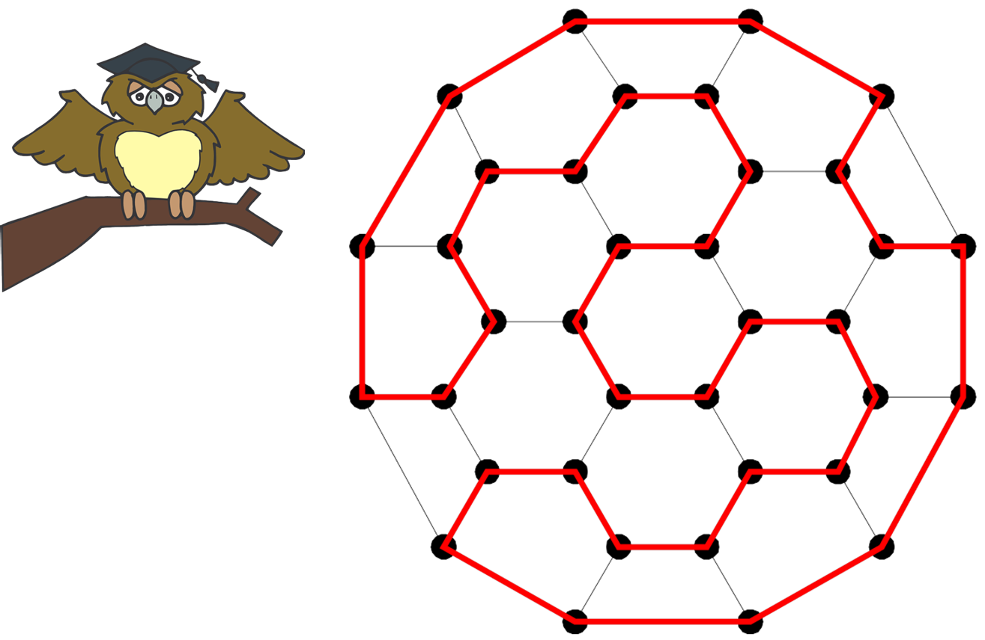

Slide 24
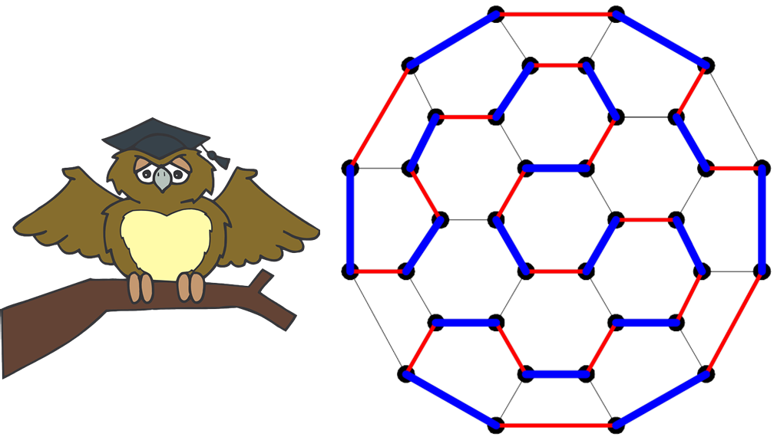

Slide 25
Now, we should know how to find a Hamiltonian cycle. Compared to the tracing problem (finding an Euler trail) in which we can just count the number of edges incident on each vertex to determine whether a connected graph can be traced in one stroke, the Hamiltonian traversal problem is much more difficult. Here, we present some simple rules:
Rule 1. Suppose that there is a vertex x of degree 2. Then a Hamiltonian cycle must include the two edges incident with vertex x.
Rule 2. One cannot return to the original vertex before passing through all of the vertices of the graph.
Rule 3. Suppose you have already traversed through vertex x. Then all edges incident with x can be ignored (as being no longer needed).

Slide 26
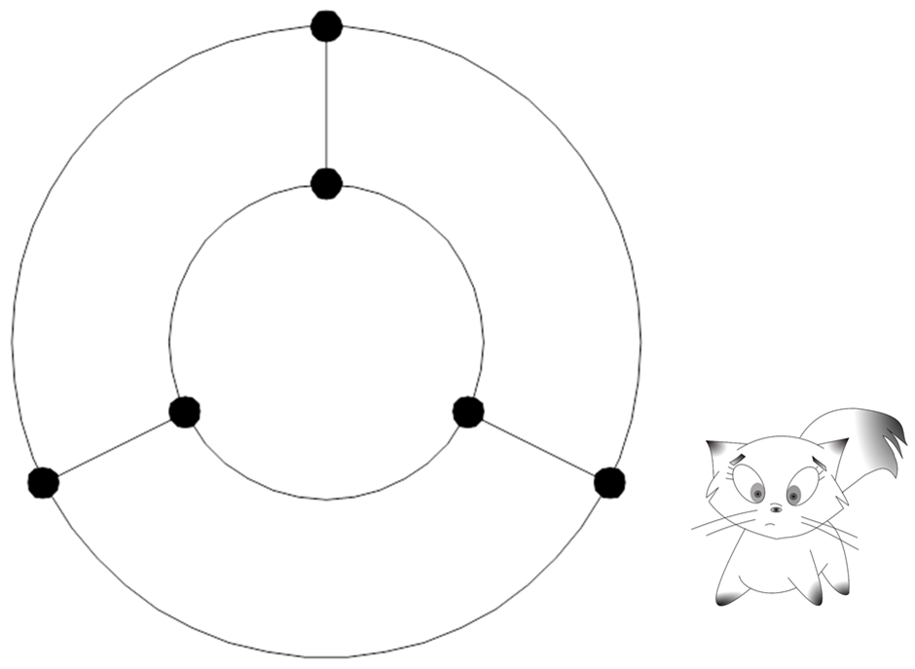

Slide 27
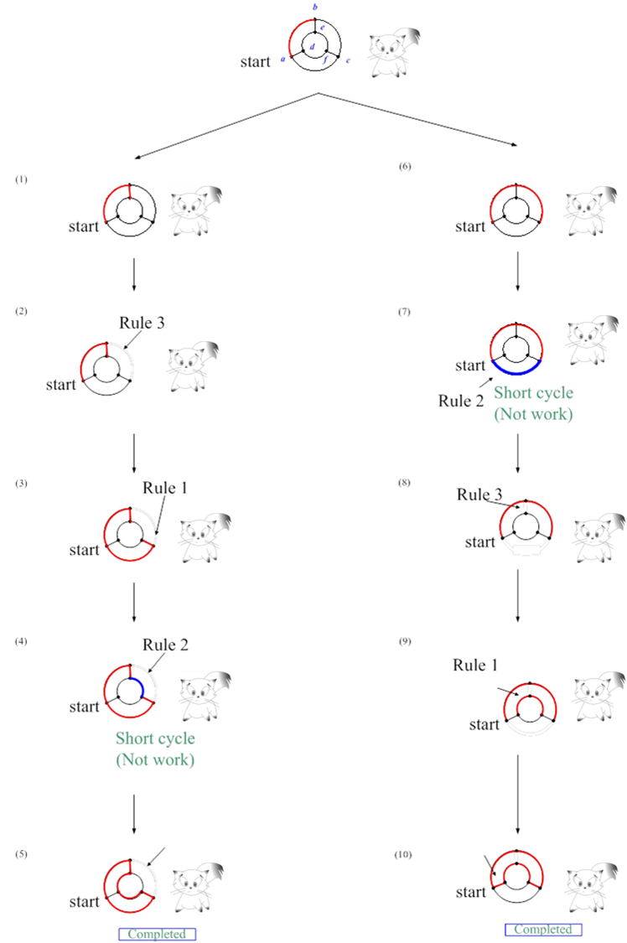

Slide 28
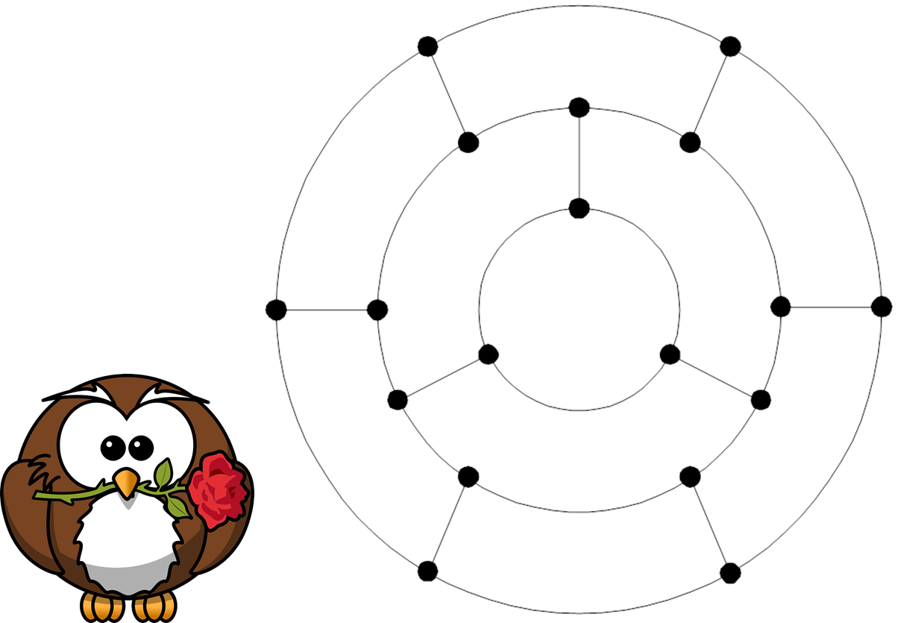

Slide 29
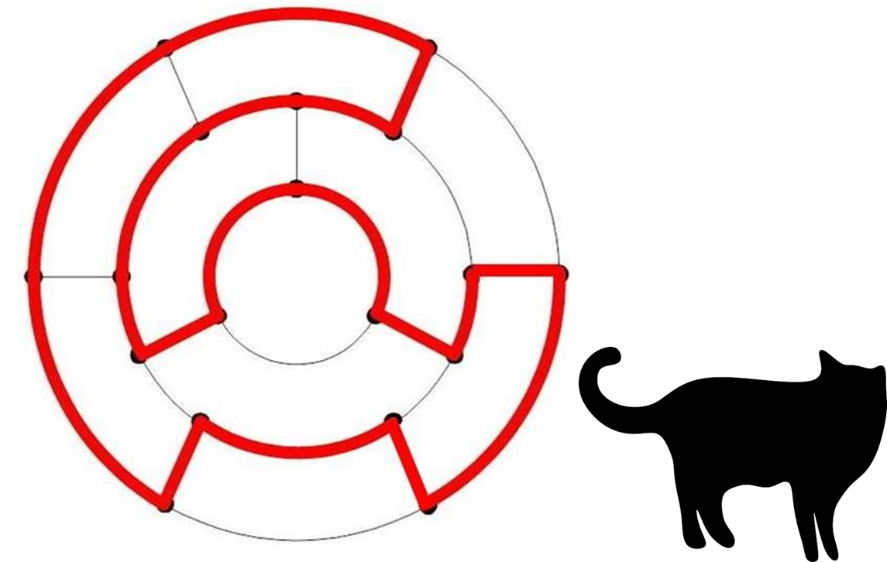

Slide 30
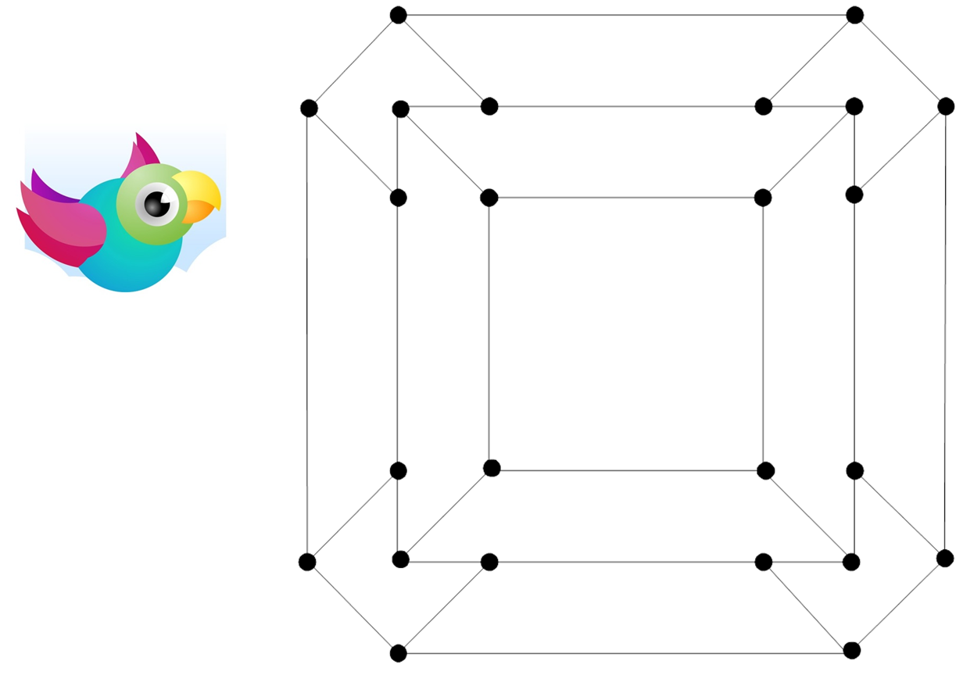

Slide 31
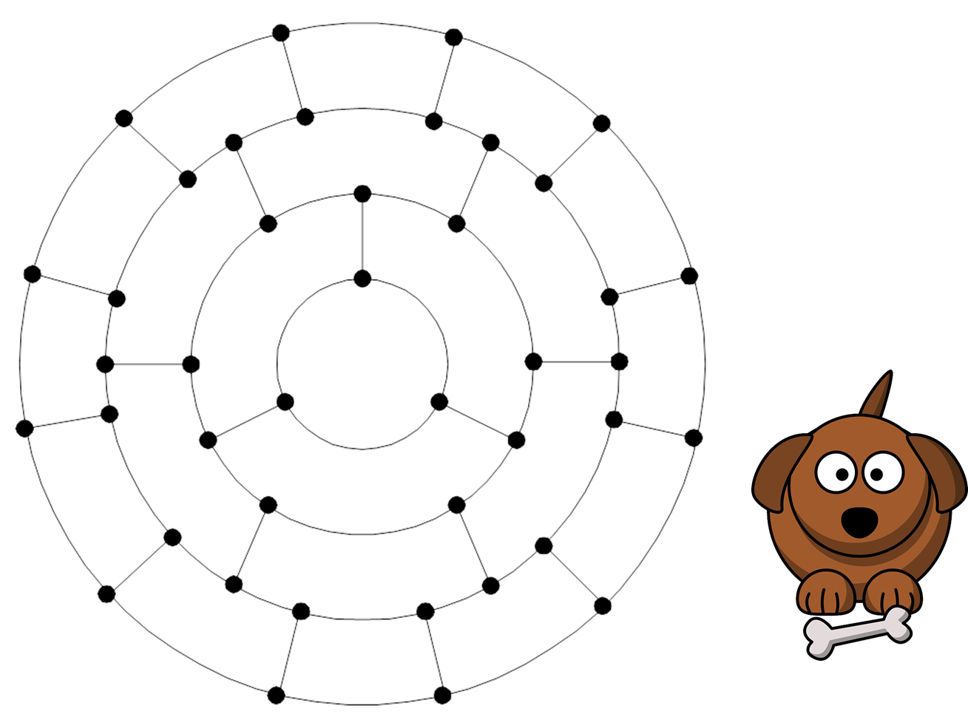
Figure 2-24

Slide 32
Nesting structure is helpful.

Slide 33
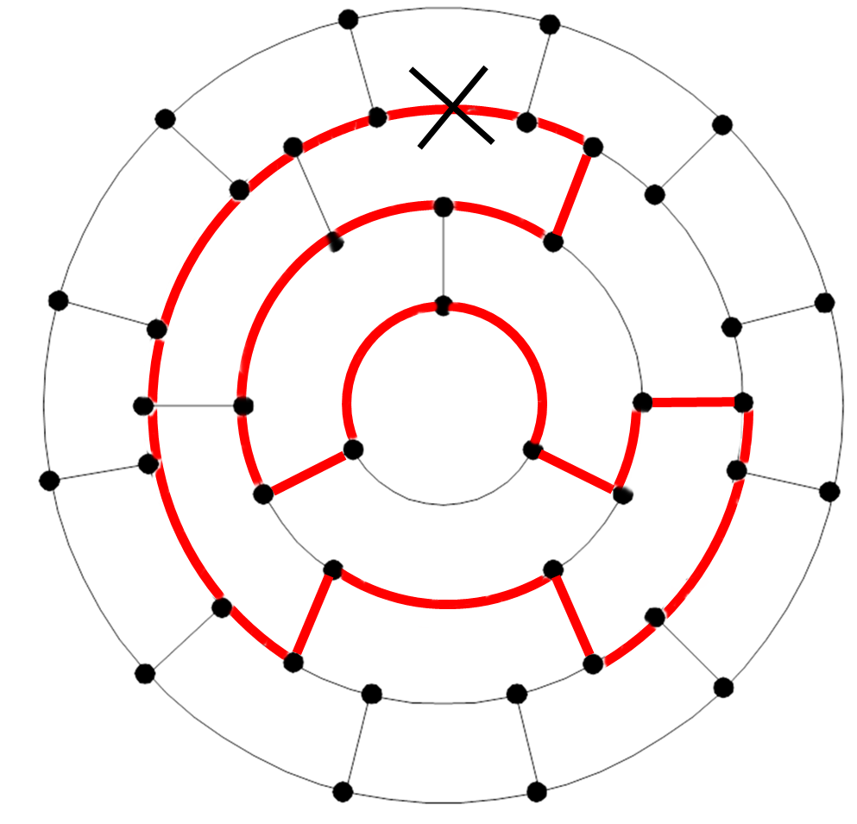
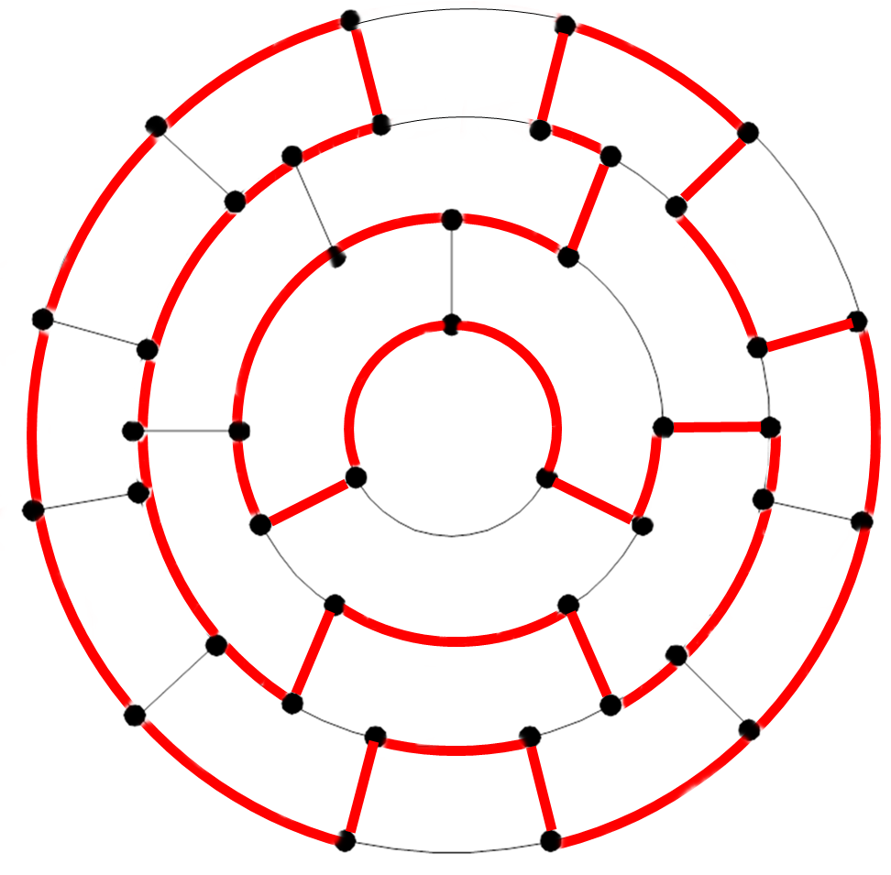
(a)
(b)
Figure 2-27

Slide 34
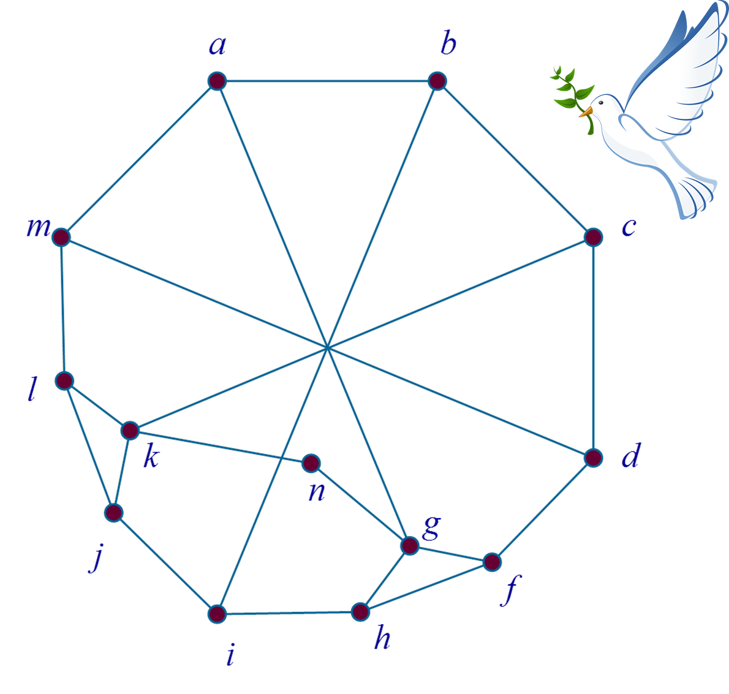
Now, can we prove that the graph is not Hamiltonian?

Slide 36
Tedious work for non-Hamiltonian graphs
CO-NP

Slide 37
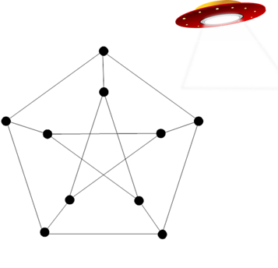
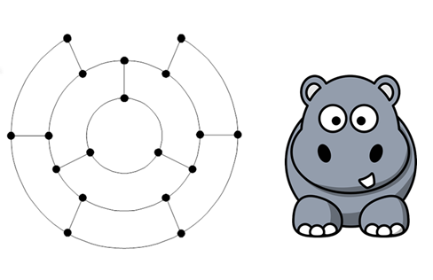

Slide 38
So, we may need tools for proving non-Hamiltonian graphs.

Slide 39
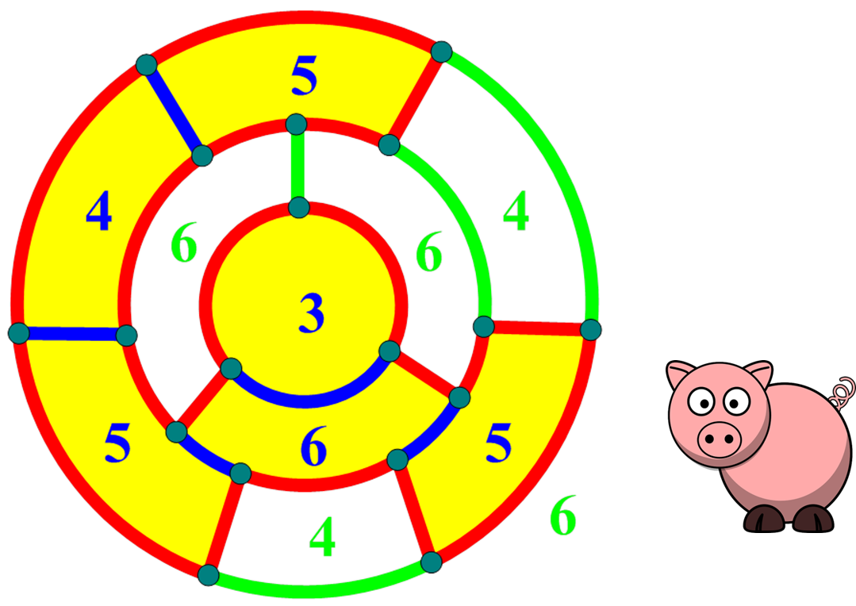
Loopless non-hamiltonian graphs

Slide 40

For any integer i, we use f_{i} to denote the number of subregions inside bounded by i edges and use g_{i} to denote the number of subregions outside bounded by i edges.
Grinberg condition: $\sum_{i}^{ }{\left(i−2\right)(f}i−g_{i})=$0.
Most difficult preliminary of this book.

Slide 41
In our example, we have f₃=1, g₃=0, f₄=1, g₄=2, f₅=3, g₅=0, f₆=1, g₆=3 and the remaining f_{i} and g_{i} are 0. Obviously, (3-2)(1-0)+(4-2)(1-2)+(5-2)(3-0)+(6-2)(1-3)=0.

Slide 43
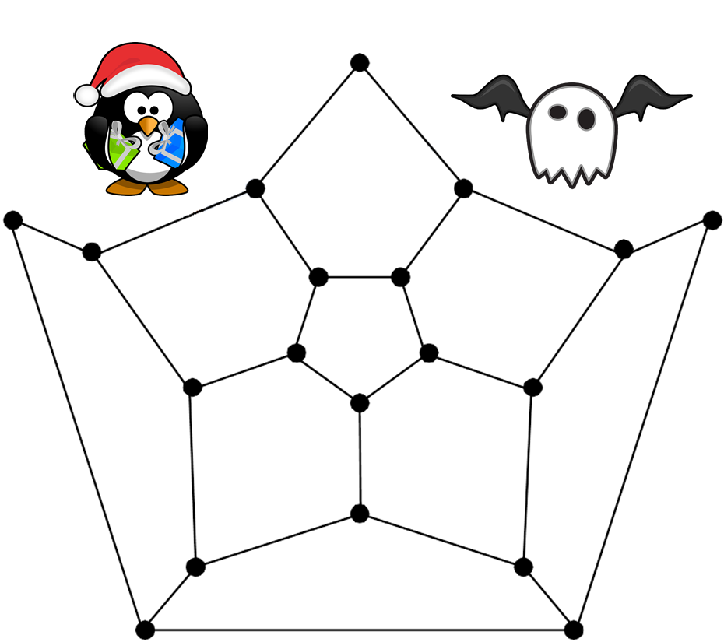

Application for Grinberg condition:
3x₅+7x₉=0.

Slide 44
Real world application
More recently, the study of Hamiltonian cycles has been fueled by the applications on computer networks.
Token ring vs Hot potato

Slide 45
The hypercube, Q_{n}, is one of the most widely-used computer networks [11]. Let S be the set of all n-tuples in which each position is 0 or 1. Obviously, S contains 2^{n} elements. The n-dimensional hypercube is the graph Q_{n} with vertex set S in which two n-tuples are adjacent if and only if they differ in exactly one position. In Figure 2-35, we illustrate Q₁, Q₂, Q₃, and Q₄. Obviously, Q_{n} is an n-regular graph for every integer n. Moreover, Q_{n} is a bipartite graph because we can divide the vertex set into two parts depending on the parity of ones at each vertex. There are many interesting properties of Q_{n} that can be found in literature.

Slide 46
Figure 2-35

Slide 47
Here, we are only interested in the Hamiltonian property of Q_{n}. It is proved that Q_{n} is Hamiltonian for every integer n greater than 1. We do not know how many total Hamiltonian cycles Q_{n} has. Yet, Q_{n} has an interesting Hamiltonian cycle known as Gray code. The Gray code was originally designed to prevent spurious output from electromechanical switches. Today, Gray codes are widely used to facilitate error correction in digital communications such as digital terrestrial television and some cable TV systems. The Gray code for n bits can be generated recursively by reflecting the bits (i.e. listing them in reverse order and concatenating the reverse list onto the original list), prefixing the original bits with a binary 0 and then prefixing the reflected bits with a binary 1. The base case, for n = 1 bit, is the most basic Gray code, 0, 1. See Figure 2-36 for illustration.

Slide 49
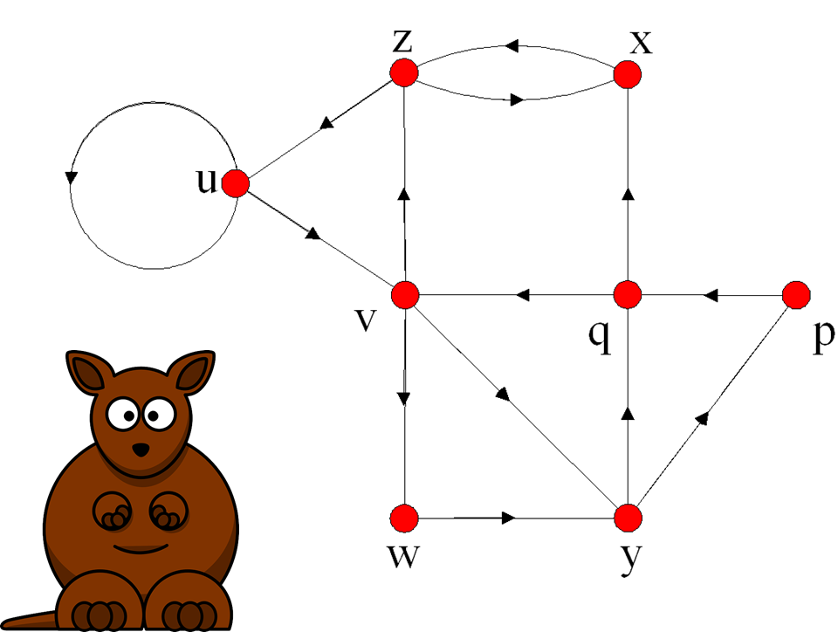

Slide 50
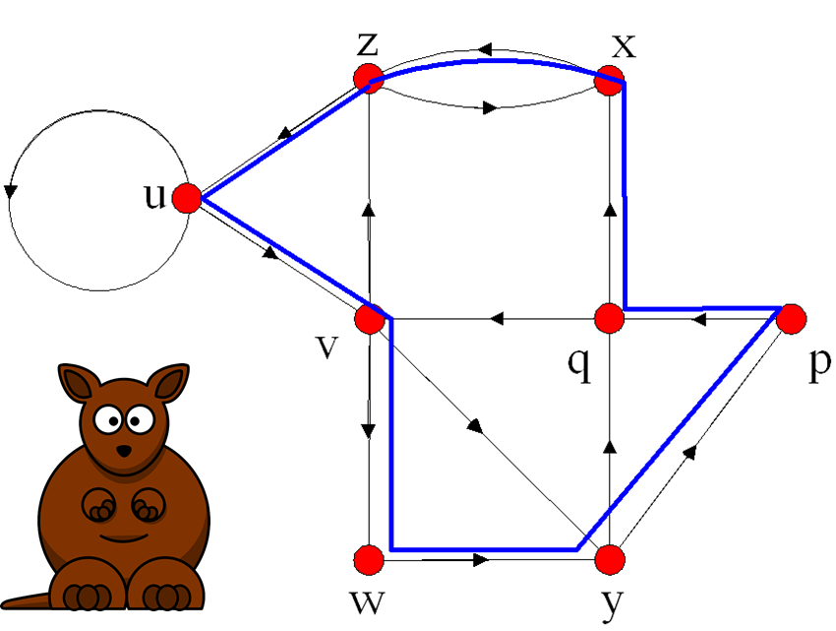

Slide 51
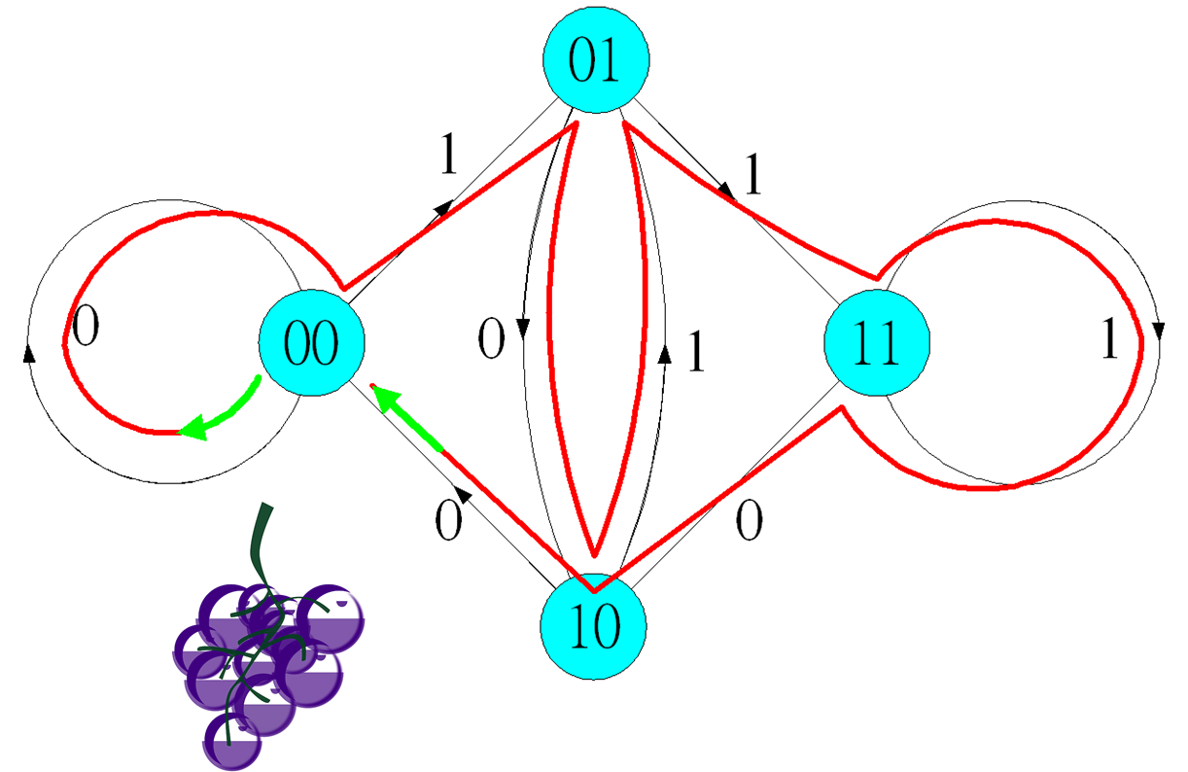
A relation of Euler circuit and Hamiltonian cycle

Slide 52
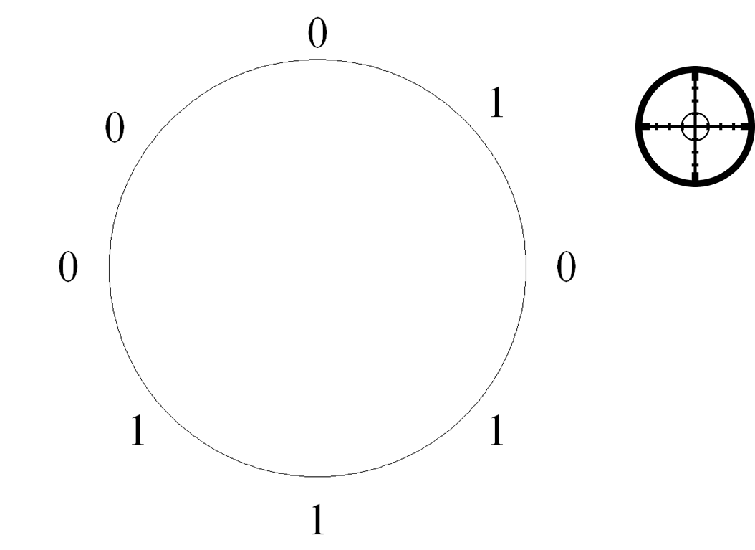

Slide 53
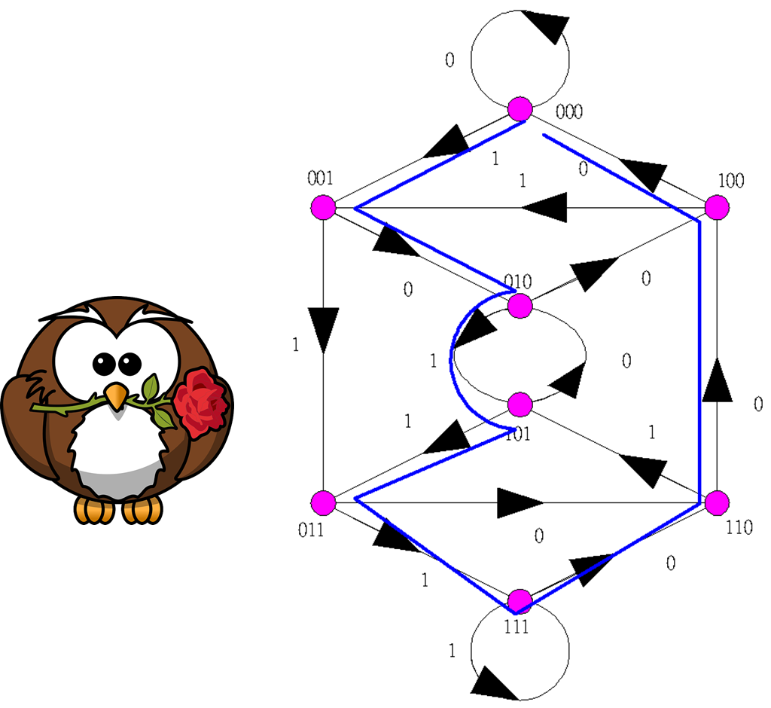

Slide 54
Hamiltonian cycle: NP-Complete
Non-Hamiltonian: CO-NP.
Hamiltonian cycle: Difficult Problem.
Non-Hamiltonian graphs: More difficult.

Slide 55
Euler graph: Easy problem.

Slide 56
My point of view
From research point of view:
Euler graphs: Difficult
Hamiltonian graphs: Easy

Slide 57
Suggested Reading and Possible Future Directions
Until the 1970’s, interest in Hamiltonian cycles was centered on their relationship to the famous Four Color Problem. The Four Color Problem states that given any separation of a plane into contiguous regions, called a map, the regions can be colored using at most four colors so that no two adjacent regions have the same color. Two regions are called adjacent only if they share a border segment, not just a point. In October 23, 1852, Sir William Hamilton received a letter from Augustus de Morgan at University College in London. In this letter, the Four Color Problem first appeared. The problem was posed also by de Morgan's student Frederick Guthrie, who later attributed its origin to his brother Francis Guthrie. The problem was phrased in terms of map coloring, in which the regions of a planar graph are to be colored. In 1878, to solve the Four Color Problem, Cayley announced the problem to the London Mathematical Society. Within a year, Kempe [8] published a “solution.” Kempe was soon thereafter elected a Fellow of the Royal Society.

Slide 58
In 1890, Heawood posed a refutation. Eventually, Appel and Haken [2,3,4] solved the four color problem. In 1878, Tait [12] proved a theorem relating face-coloring of planar maps to 3-edge-coloring of planar graphs. The puzzle of Kingdom Without Numbers is actually a 3-edge-coloring of planar graphs. Tait believed that his approach gave a proof of the Four Color Theorem because he assumed that every 3-connected cubic planar graph is Hamiltonian. (A graph is 3-connected if it remains connected if any two vertices are deleted.) Although the gap was noticed earlier, an explicit counterexample was found in 1946. Yet, the proof of this counterexample, that a 3-connected cubic planar graph is not Hamiltonian, is very tedious. Later, Grinberg [7] discovered a simple necessary condition that led to many cubic 3-connected non-Hamiltonian planar graphs.

Slide 59
One important aspect of Hamiltonian cycles that interested scholars is its computational complexity [6]. Computational complexity theory is a branch of the theory of computation in computer science that focuses on classifying computational problems according to their inherent difficulty. In computational complexity theory, the problem of determining a graph to be Hamiltonian is classified as NP-complete. Problems in NP-complete have the following two properties:
Any given solution to the problem can be verified quickly (in polynomial time); the set of problems with this property is called NP (nondeterministic polynomial time).
If the problem can be solved quickly (in polynomial time), then so can every problem in NP.

Slide 60
Although any given solution to such a problem can be verified quickly, there is no known efficient way to locate a solution in the first place; indeed, the most notable characteristic of NP-complete problems is that no fast solution to them is known. That is, the time required to solve the problem using any currently known algorithm increases very quickly as the size of the problem grows. As a result, the time required to solve even moderately large versions of many of these problems easily reaches into the billions or trillions of years, using any amount of computing power available today.
Thus, we may not have an efficient algorithm to find a Hamiltonian cycle for a given graph. Yet, we can easily verify that a particular cycle is indeed a Hamiltonian cycle. Checking that a graph is non-Hamiltonian, which is classified into co-NP in computational complexity theory, is much more difficult.

Slide 61
Mathematicians are interested in classifying certain families of graphs, such as Hamiltonian. Now, we introduce one such family. The generalized Petersen graphs are a family of cubic graphs formed by connecting the vertices of a regular polygon to the corresponding vertices of a star polygon. They include the Petersen graph and generalize one of the ways of constructing the Petersen graph. The generalized Petersen graph family was introduced in 1950 by H. S. M. Coxeter [5] and these graphs were given their name in 1969 by Mark Watkins [13].
In Watkins' notation, G(n,k) is a graph with vertex set {u₀, u₁, ..., u_{n−1}, v₀, v₁, ..., v_{n−1}} and edge set {(u_{i} u_{i+1}), (u_{i} v_{i}), (v_{i} v_{i+k}) | i = 0,...,n − 1} where subscripts are to be read modulo n and k < n/2.

Slide 62
For example, the left graph in Figure 2-27 is GP(5,2) which is also know as a Petersen graph. It was proved by Alspach [1] that G(n,k) is non-Hamiltonian if and only if n=6m+5 with n=2, or 3m+2 for some integer m.

Slide 63
Problem
There are many interesting remaining problems with Hamiltonian cycles. Here, I propose one possibility. A family of dense trivalent graphs DT_{n} was proposed by Leland and Solomon [10] for any positive integer n with n>1. The vertex set of DT_{n} is the set of binary strings of length n. Thus, V(DT_{n})={s₀s₁,…,s_{n-1} | s_{i} ∈ {0,1}}. Vertex s₀s₁,…,s_{n-1} is adjacent to vertex z₀z₁,…,z_{n-1} if and only if one of the following three conditions holds: (1) s_{i}=z_{i-1} for 0 ≤ i ≤n-2 and s_{n}=1-z₀, (2) s_{i}=z_{i-1} for 1 ≤ i ≤n-1 and s₀=1-z_{n-1}, and (3) s_{i}=z_{i} for 0 ≤ i ≤n-3 and s_{i}=1-z_{i} for i=n-2 and n-1. My conjecture is that every DT_{n} is Hamiltonian. However, I note that DT_{n} is not a cubic graph if n is odd.

Slide 64
References
Alspach, B. R. (1983), "The classification of Hamiltonian generalized Petersen graphs", Journal of Combinatorial Theory, Series B 34: 293–312.
Appel, K. and Haken, W., Every planar map is four colorable, Bulletin of the American Mathematical Society, 82, 711, 1976.
Appel, K. and Haken, W., Every planar map is four colorable, Part I: discharging, Illinois Journal of Mathematics, 21, 429, 1977
Appel, K. and Haken, W., The four color proof suffices, The Mathematical Intelligencer, 8, 10, 1986.
Coxeter, H. S. M. (1950), "Self-dual configurations and regular graphs", Bulletin of the American Mathematical Society 56: 413–455.
Garey, M.R.; Johnson, D.S. (1979). Computers and Intractability: A Guide to the Theory of NP-Completeness. New York: W.H. Freeman. ISBN 0-7167-1045-5.

Slide 65
Grinberg, E.J., Plane homogeneous graphs of degree three without Hamiltonian circuits, Latvian Mathematical Yearbook, 5, 51, 1968.
Kempe, A.B., On the geographical problem of the four colors, American Journal of Mathematics, 2, 193, 1879.
Kirkman, T.P., On the representation of polyhedra, Philo. Trans. Roy. Soc. Lond. Ser. A, 146, 413, 1856.
Leland W. and Solomon M., Dense trivalent graphs for processor interconnection, IEEE Transaction on Computers, Volume 31, Issue 3, March 1982, page 219-222.
Leighton, F.T., Introduction to Parallel Algorithms and Architecture: Arrays · Trees · Hypercubes, San Mateo, Morgan Kaufmann, 1992.
Tait, P.G., On the colouring of maps, Proceedings of the Royal Society of Edingburgh, 1880, 501.
Watkins, Mark E. (1969), "A Theorem on Tait Colorings with an Application to the Generalized Petersen Graphs", Journal of Combinatorial Theory 6: 152–164.

Slide 66
The vertex set of DT_{n} is the set of binary strings of length n. Thus, V(DT_{n})={s₀s₁,…,s_{n-1} | s_{i} ∈ {0,1}}. Vertex s₀s₁,…,s_{n-1} is adjacent to vertex z₀z₁,…,z_{n-1} if and only if one of the following three conditions holds: (1) s_{i}=z_{i-1} for 0 ≤ i ≤n-2 and s_{n-1}=1-z₀, (2) s_{i}=z_{i-1} for 1 ≤ i ≤n-1 and s₀=1-z_{n-1}, and (3) s_{i}=z_{i} for 0 ≤ i ≤n-3 and s_{i}=1-z_{i} for i=n-2 and n-1.

Slide 67
Lovasz conjecture: too far!

Slide 68
V(DT_{n})={s₀s₁,…,s_{n-1} | s_{i} ∈ {0,1}}.
s₀s₁,…,s_{n-1}, s₁,…,s_{n-1}(1-s₀)
s₀s₁,…,s_{n-1}, (1-s_{n-1}) s₁,…,s_{n-2}
s₀s₁,…,s_{n-1}, s₀s₁,…, (1-s_{n-2})(1-s_{n-1})
Why: smaller diameter

